Slide 1
Finding a Place to Live
by Andres Navarre
2020

Slide 2
New immigrants to Canada are looking for a place to live
Around 50% of new immigrants land first in Toronto

Slide 3
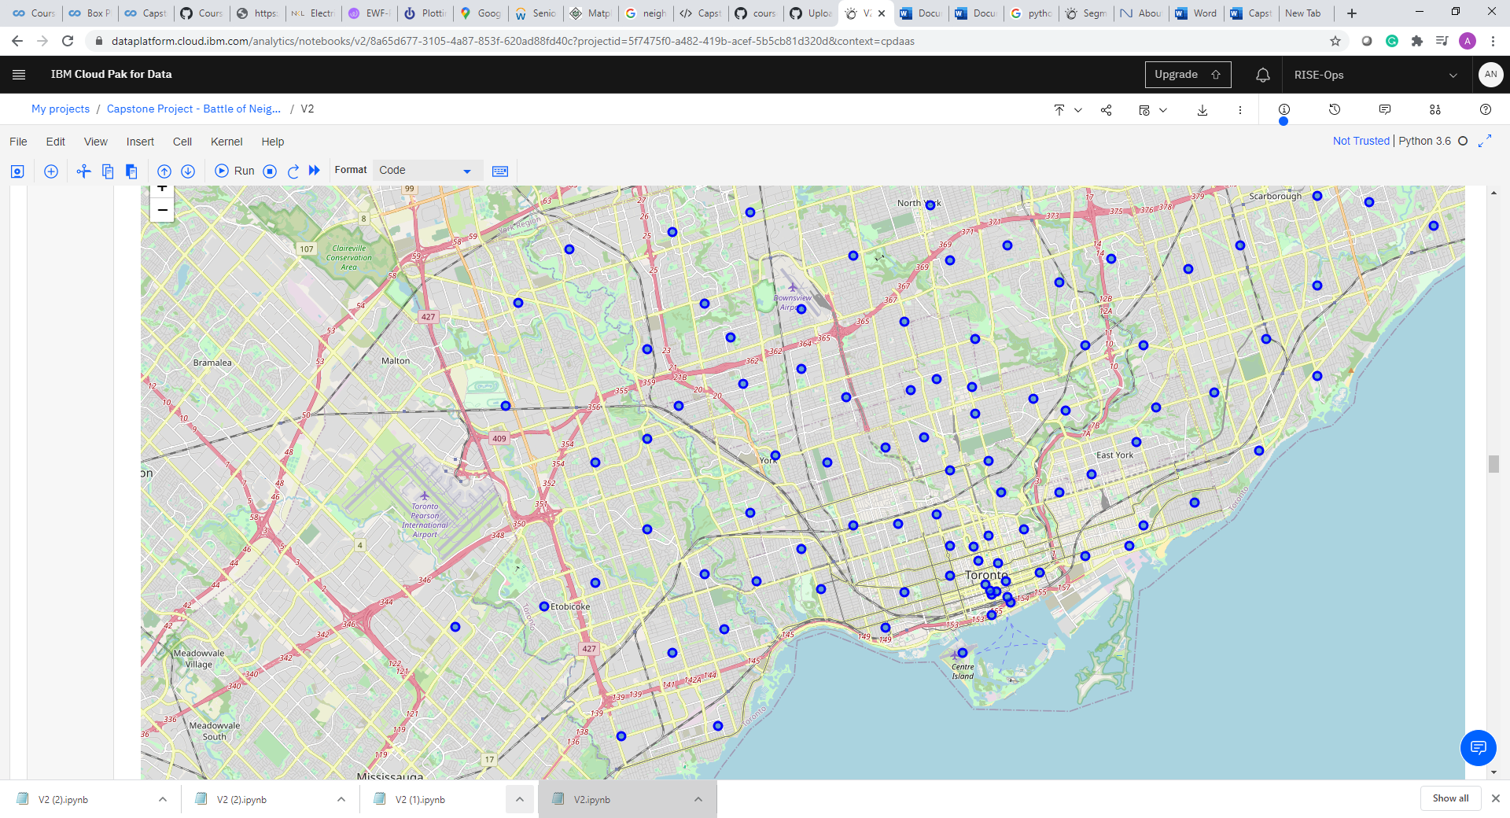
Where can they find a place to live?
It will depend in different factors.
In this analysis we include housing prices, schools rankings and kind of venues that are located in neighborhoods

Slide 4
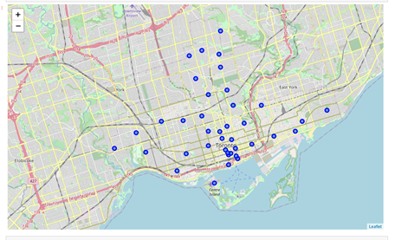
Methodology
We consider different elements:
1. Income and Population
K-means clusters of neighbourhoods (simplified into 15 clusters)
House prices and Schools rankings

Slide 5
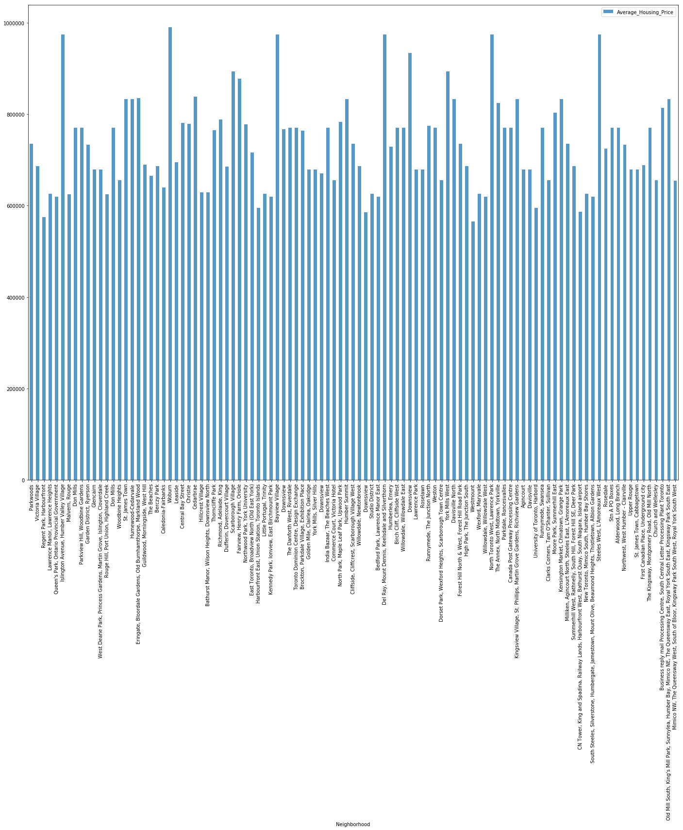
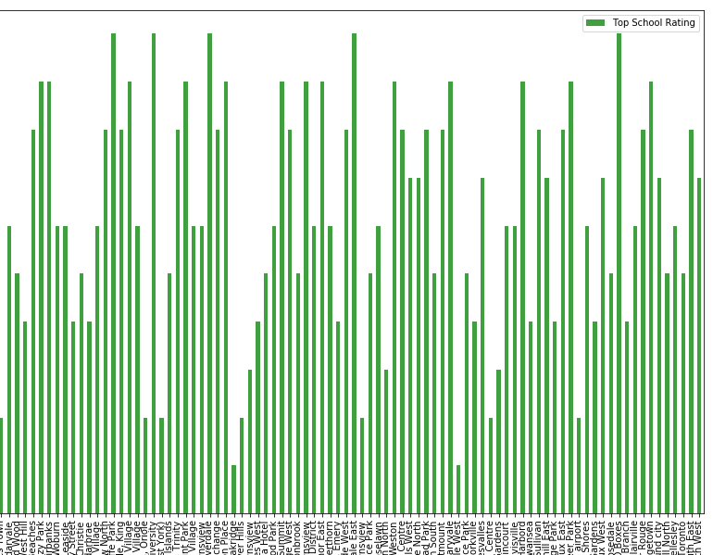
House Prices and School ranking by Neighbourhood in Toronto

Slide 6
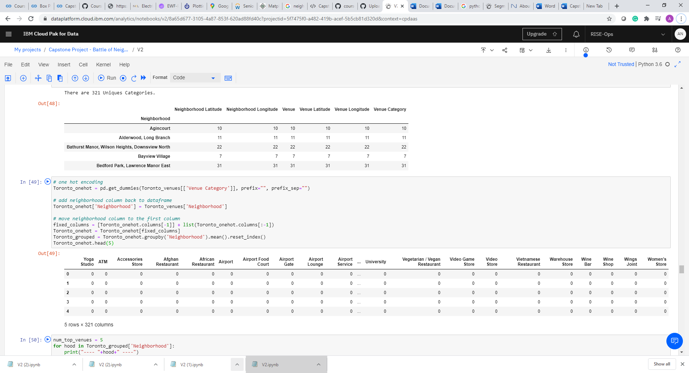
Venues in Neighborhoods
We identify different venues that can respond to migrants needs, like coffe shops, super markets, etc

Slide 7
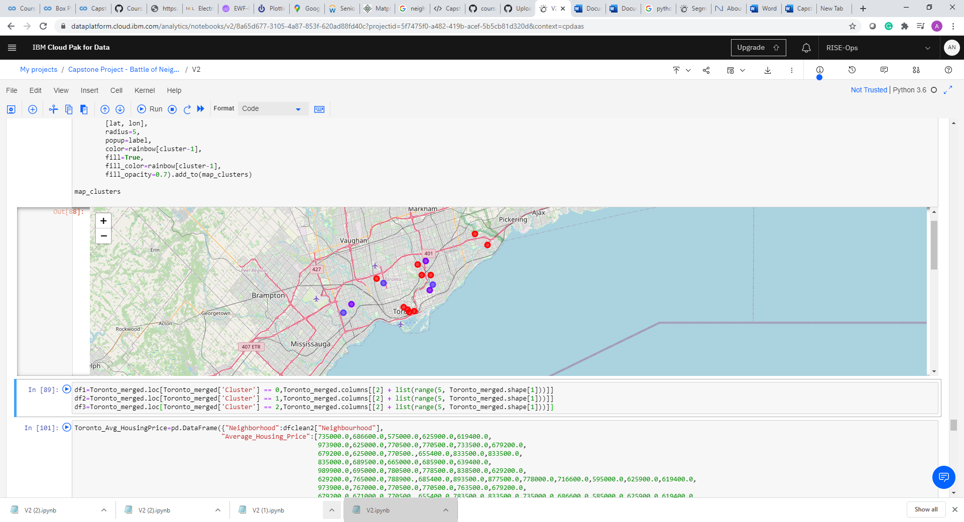
Basket of services
We identify by cluster of neighbourhoods the basket of services that can be find

Slide 8
Conclusion
This analysis provides a informative data structure of what can be found when immigrants land into the country. I tried to portray some elements that can be included with data to the decision making.
The tools used here are very powerful because it provides elements that were not possible to include before life geo-reference location.
Nevertheless, at the end of the day, it will depends in many factors that could be not general, like work location, school needs for older children, closeness to relatives and many others

Slide 9
Recommendations
Include more variables of the ones are here proposed
Use a more updated dataset that provides a more accurate result of the current situation
Find cultural needs, because for some communities, it could be a differentiator

